Slide 1
수요세미나
경영학과 강성모
ksungmo@cnu.ac.kr

Slide 2
Contents
01
Introduction
02
Research streams
03
Research idea

Slide 3






Introduction

Slide 4
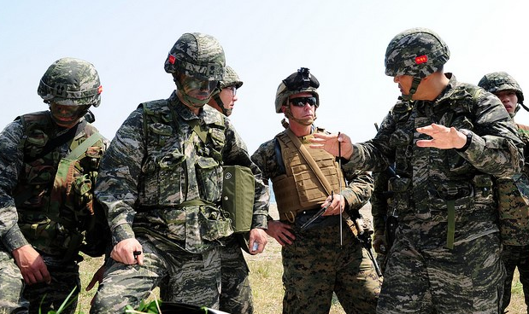
Inspiration
What factors influence a team’s effectiveness?
and
How can teams become more effective?

Slide 5
Team Researcher
What factors influence a team’s effectiveness?
How can teams become more effective?
Leadership
Diversity
Communication

Slide 6
Foundations of Team Effectiveness
Leadership
Diversity
Communication
Park, HM., Kang, SM.*, Kim, NY., & Kwon, SJ. Alignment matters: The joint effects of inclusive leadership disparity and LMX alignment on inclusion. (Under review at Journal of Organizational Behavior)
Kang, SM.*, & Kang, YJ. LMX differentiation, leader political skill, and team effectiveness: Evidence for curvilinear and interaction effects. (Data analysis for Journal of Management)
Pahng, HM., & Kang, SM.* The effect of LMX differentiation on team information elaboration. (Preparing manuscript for Small Group Research)
Valladares, C. & Kang, SM.* Movers or thinkers: The effect of new venture teams’ regulatory mode on innovation. (1st Round R&R at International Entrepreneurship and Management Journal)

Slide 7
Foundations of Team Effectiveness
Leadership
Diversity
Communication
Chamberlin, M.*, Howe, M., Kang, SM., & Summers, J. Hanging in the balance: The effect of promotive and prohibitive voice congruence on team performance (Under review at Academy of Management Journal)
Kang, SM.*, Chamberlin, M., Summer, J., & Pychlau, S. Sending signals: The effects of voice endorsement disparity on team effectiveness. (PhD dissertation & Ready for submission: Academy of Management Journal)

Slide 8
Foundations of Team Effectiveness
Leadership
Diversity
Communication
Pahng, P., Kang, SM.*, Telkamp, J. B., & Kang, YJ. Extravert ideal? Extraversion diversity and its impact on team creativity. (1st R&R stage at Human Performance)
Bohle, S. L., Kang, SM.*, Medina, F. M., & Park, HM. Cultural and gender differences: The effect of job insecurity on taking charges and its boundary conditions. (Preparing manuscript for submission for Equality, Diversity and Inclusion)
Telkamp, J. B., Pahng, P., Kwon, SJ., & Kang, SM.* "Can't Stand Ya!" The effect of political ideology diversity on team effectiveness. (Under review at Small Group Research)

Slide 9
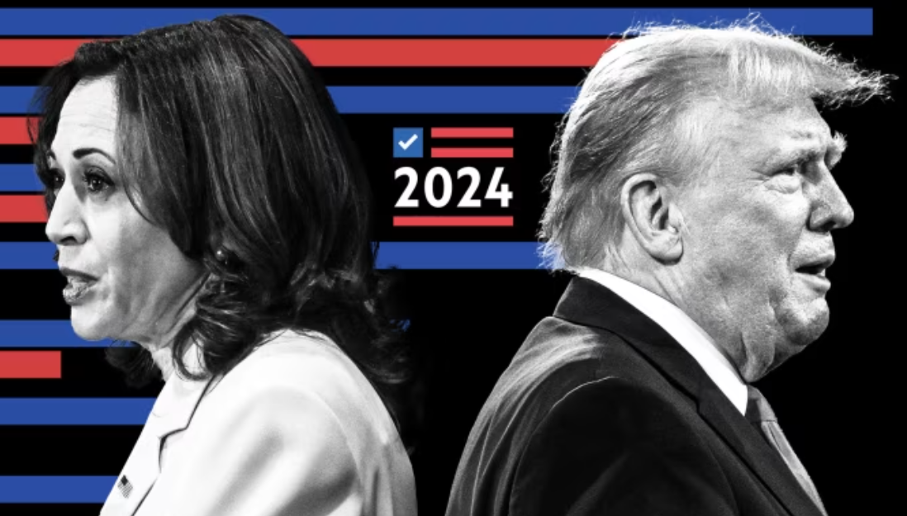
Research Idea
“Can’t Stand Ya!” The Effect of Political Diversity on Team Effectiveness
Jake B. Telkamp¹, Phoebe Pahng², Sang Jib Kwon³, & Sung Mo Kang^{4*}
1. Augusta University
2. California State University, Sacramento
3. Hansung University
4. Chungnam National University (correspondence)

Slide 10
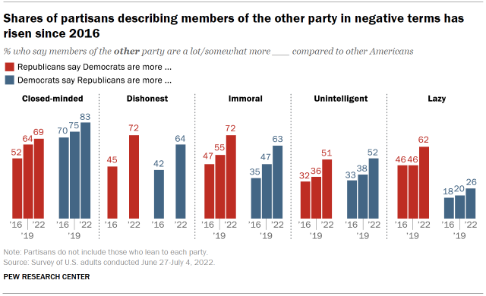
Politics… Politics… Politics…
Roughly 40% of South Korea adults surveyed were uneasy about sharing meals with those who have different political ideologies (Lim, 2023)
Similar rise in polarization in the US (Tyler & Iyenger, 2023).
Polls showing people of other parties are seen as immoral

Slide 11
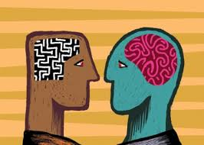
Politics do not go away at work, they affect:
Judgment of job applicants (Roth et al., 2020)
Engagement in ally work (Dang & Joshi, 2023)
CEO attitudes toward CSR and downsizing (Chin et al., 2013; Gupta et al., 2019), and toward stakeholders (Thams & Dau, 2023)
How CEOs are paid (Chin & Semadeni, 2017; Gupta & Wowak, 2017).
Political conversations at work → resource depletion, helped their coworkers less, and were more withdrawn (Kim et al., 2022).
Notes:
3. 자유주의, 민주주의 → 사회적 기업, downsizing 덜 함.
4. Given that politically liberal individuals tend to value egalitarianism, we test whether firms with liberal CEOs tend to (1) reduce pay dispersion among non-CEO executives; and (2) reduce pay gaps between CEO and non-CEO executives, and whether compensation committee liberalism moderates these relationships.

Slide 12
Yet we know almost nothing about how political diversity functions in teams
Despite increased attention and calls for understanding politics at work (Swigart et al., 2020)
Is it harmful to team dynamics, or is it a source of insight?
We need a better understanding of political diversity on teams to make progress toward depolarization

Slide 13
Competing Theories of Team Diversity
Diversity is harmful!
- Similarity-attraction theory (Byrne, 1971)
People tend to be more attracted to others who are perceived as more similar
Homogeneous teams are likely to be more productive than heterogeneous teams because of mutual attraction of team members with similar characteristics
- Social identity (Tajfel, 1978) & Social-categorization (Turner, 1999) theories
People define and differentiate themselves in terms of group memberships.
Categorization processes may be triggered when members are dissimilar (ingroup vs. outgroup)

Slide 14
Competing Theories of Team Diversity
Diversity is helpful!
- Cognitive resource diversity theory (Triana & Garcia, 2009)
Diversity provides for a larger pool of knowledge and perspectives
Diverse perspectives improve the team’s ability to consider alternative interpretations and generate creative solutions that integrate diverse perspectives
Diversity enhances a team’s network of external contacts

Slide 15
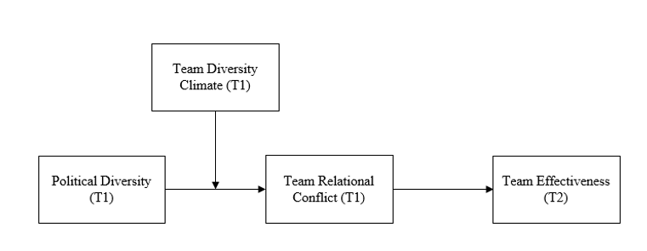
We propose it’s generally a source of conflict
But that there are buffers to try and reduce that “categorization” of perceived outgroup members

Slide 16
Theory Background: Political Affiliation Model (PAM)
People like those with similar political affiliations (Roth et al., 2017)
Have overly positive work evaluations of similar party organizational applicants, over-and-above work relevant information (Roth et al., 2020)
And a general disliking toward those of differing political beliefs (Finkel et al., 2020; Roth et al., 2020; Wade et al., 2020).
PAM suggests political affiliations impact judgments toward other potential employees regarding their work ability
We draw from PAM and integrate it with the diversity literature

Slide 17
PAM & SCT (Social Categorization Theory)
SCT: Social categorization is a process whereby we make sense of the world around us by separating things into different classes or groups.
Categorization (“US vs. Them!”)
Political diversity (because of increased disliking and poorer work judgments) will lead to a greater reliance on the categorization.
H1: Political diversity is positively associated with relationship conflict.

Slide 18
Diversity Climate as a Buffer
“Shared perceptions among employees in a unit that people are treated fairly and are integrated into work environment regardless of background” (Chung et al., 2015, p. 1496)
May provoke a 'de-categorization' process in teams (Drach-Zahavy & Trogan, 2013)
Usually studied via demographic diversity, but we believe findings may apply to political diversity too (Holmes et al., 2021)
H2: Diversity climate moderates the positive relationship between political diversity and relationship conflict, such that when there is a higher level of a diversity climate, there will be less relationship conflict on the team.

Slide 19
Team Effectiveness
Relationship conflict is usually detrimental to team performance (De Dreu & Weingart, 2003; De Wit et al., 2012; Mathieu et al., 2019)
H3: Relationship conflict mediates the negative relationship between political diversity and team effectiveness.
H4: Higher levels of a diversity climate will weaken the mediating effect of relationship conflict between political diversity and team effectiveness.

Slide 20
Methods
Time-lagged field study from South Korean organizations
Social welfare, entertainment, distribution, food manufacturing, and healthcare industries
SK political parties are similar to the US parties (Democratic Party of Korea & People Power Party)
If team members recognize political ideology of other members, we excluded them from the analysis
Final sample: 70 teams, 372 team members and 70 team leaders.
Time 1: Team members rated: Political ideology, relationship conflict, and perceived diversity climate
Time 2: One month later, leaders rated team effectiveness

Slide 21
Measures
Political Diversity (Lawson & Kakkar, 2022)
Two-item scale which measures political orientation and the political orientation of their preferred political party on a scale from 1 (very liberal) to 7 (very conservative).
α = .97; Measured as separation (Harrison & Klein, 2007; Swigart et al., 2020)
Standard deviation of team members political orientation
Team Relationship Conflict (Jehn, 1995)
Four-item scale (1 = “strongly disagree” 5 = “strongly agree”)
“There is tension among members of my work unit” and “There is emotional conflict among members in my work unit.”
α = .93
Team Diversity Climate (Chung et al., 2015)
Five-item scale (1 = “strongly disagree” 5 = “strongly agree”)
“My coworkers help me feel like an important part of the team” and “My coworkers appreciate my background and perspective.”
α = .93

Slide 22
Measures
Team Effectiveness (Pearce & Sims, 2002)
Team leaders: 4-item scale adopted by, ranging from 1, “strongly disagree,” to 5, “strongly agree.”
“My team is highly effective” and “My team does very good work.” (α = .94)
Control Variables
Following prior diversity research
Team mean level of political ideology since team mean level of political ideology and standard deviations across teams can be confounded due to an artifactual overlap (Harrison & Klein, 2007).
Team size (the number of team members excluding a team leader) since previous literature consistently showed that team size affects team dynamics and outcomes (e.g., Smith et al., 1994).
Team member organizational tenure (the mean level of aggregated team member’s tenure) since the mean level of individual member’s organizational tenure can influence their overall performance (Ng & Feldman, 2013).
Industries, using dummy variables, since our data includes various types of organizations, including non-profit and for-profit organizations.
Gender and age diversity
Of the 372 team members, 1/3 women, average age = 35 years (SD = 5.15), organizational tenure = 5.6 years (SD = 3.71). Of 70 team leaders, 34.3% were women, average age = 42.5 years (SD = 3.82), average organizational tenure = 10.6 years (SD = 3.82).

Slide 23
Analyses & Results
The two-level CFA revealed that the proposed four-factor model has an acceptable fit (Hu & Bentler, 1999): χ² (43) = 137.73, p < .01, RMSEA= .07, CFI = .98, TLI = .97, SRMR individual-level = .03, SRMR team-level = .04
Path analysis in MPlus

Slide 24
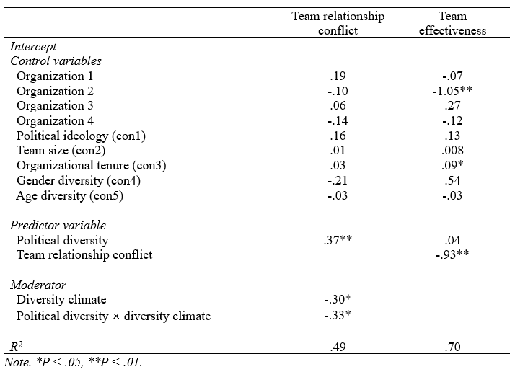
Analyses & Results

Slide 25
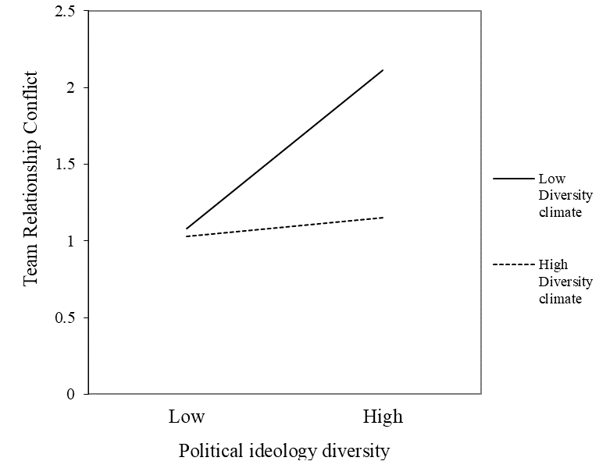
Analyses & Results

Slide 26
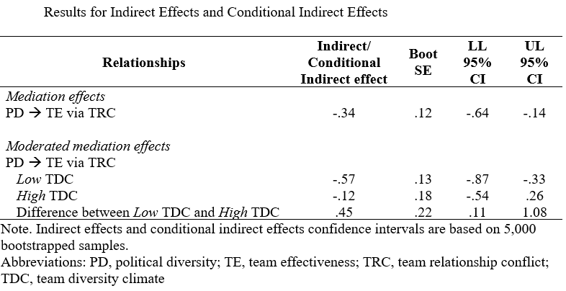
Analyses & Results

Slide 27
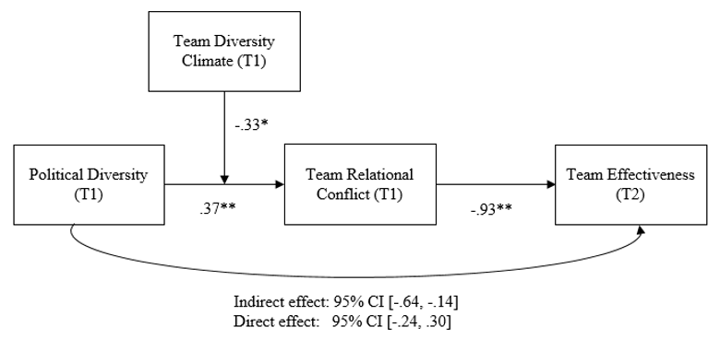
Analyses & Results

Slide 28
Contributions
1. Understanding of politics at work, specifically on teams.
2. Extend scope of PAM, and show its principles apply in team settings too
3. Extend understanding of diversity climate, and showing it has benefits in political diversity settings beyond demographic diversity

Slide 29
Future directions
Experiments
Does demographic diversity (e.g., age, gender) interact with political diversity?
More cultures
Individual political ideology, such as being liberal (conservative) in a team full of conservatives (liberals) affect team functioning/individual performance?

Slide 30

Q & A
THANK YOU!

Slide 31
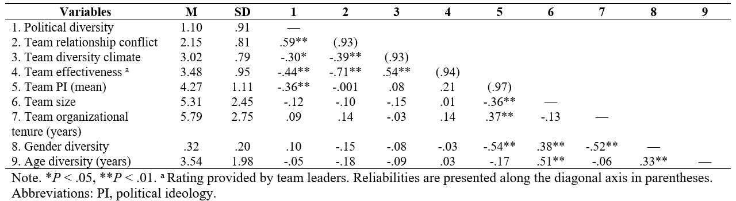
Analyses & Results

