Slide 1
Offshoring, job creation, and job destruction in South Korea
Revision has been submitted to Journal of Asian Economics.
Minjung Kim
Associate professor
Chungnam National University
Acknowledgements
The author is grateful to Professor McLaren at University of Virginia who generously provided valuable comments and suggestions on this research. The author is also grateful to participants at the trade group meeting seminar at University of Virginia, the 2023 North American Summer Meeting (NASM) of the Econometric Society, and the 49th Eastern Economic Association Annual Conference for their constructive comments and suggestions.
This research uses the remote access service of Microdata Integrated Service (MDIS, RAS19051603) provided by Statistics of Korea for the data analysis. This work was supported by the Ministry of Education of the Republic of Korea and the National Research Foundation of Korea (NRF-2022S1A5A2A01047487).

Slide 2
Introduction

Slide 3
Background
International trade and foreign direct investment (FDI) are closely associated with GVCs.
One-third of global production and half of global trade is associated with multinational enterprises (MNEs) (OECD, 2018).
It is widely believed that offshoring activities contribute to job losses in South Korea.
Reshoring policies have become more attractive to policymakers based on the belief that they would increase job creation at home.

Slide 4
Background
In Korea, President Moon Jae-in stated during his address in May 2020 that his administration would increase incentives to motivate Korean businesses to return their production facilities to South Korea.
Since the COVID-19 outbreak, reshoring policies have gained more attention in many countries, including countries such as the United States and South Korea that are heavily engaged in GVCs.
Although the United States has used reshoring policies for decades, they are relatively new to South Korea.

Slide 5
Related Literature
Effect of offshoring on employment is theoretically ambiguous, with controversial debate on this issue ongoing.
Grossman and Rossi-Hansberg (2008) proposed a theoretical model for offshoring using a new framework known as “trade in tasks”
Suggesting the productivity effect, the job displacement effect and the terms of trade effect.
Productivity channel is as a source of a wage increase

Slide 6
Related Literature
Boehm et al. (2020) suggested that two opposing forces determine the impact of offshoring on employment.
“Scale effect” : Decrease in unit costs; thus, the optimal scale of production increases, indicating a positive effect on employment and induces job creation.
“Reallocation effect” : directly reduces employment and causes job destruction.
The positive net effect implies that offshoring and domestic employment are complementary, whereas the negative net effect implies that they are substitutes.

Slide 7
Related Literature
Theoretical models of multinational firms deciding production process location and intra-firm or arm’s length sourcing strategies based on product contract friction (Antras, 2003; Antras and Helpman, 2004; Grossman and Helpman, 2005; Bernard et al., 2010)
Significant variation in intra-firm and arm’s length imports across importing products and countries in the United States.
Intra-firm imports tend to be capital-intensive goods whereas arm’s length imports tend to be labor-intensive goods (Antras, 2003; Bernard et al., 2010).

Slide 8
Contribution
In South Korea, the impact of offshoring is often anecdotal, due to the limited number of empirical studies undertaken.
Although this research follows a similar approach to that of Boehm et al. (2020), we explicitly measure the sourcing strategies of firms and investigate the effect of those activities on employment growth.
We observe whether firms participate in arms-length offshoring, intra-firm offshoring, arms-length domestic sourcing, and intra-firm domestic sourcing, and the value associated with each sourcing strategy.

Slide 9
Contribution
In South Korea, the impact of offshoring is often anecdotal, due to the limited number of empirical studies undertaken.
Explicitly measuring the sourcing strategies of firms and investigate the effect of those activities on employment growth.
Observing whether firms participate in arms-length offshoring, intra-firm offshoring, arms-length domestic sourcing, and intra-firm domestic sourcing, and the value associated with each sourcing strategy.

Slide 10
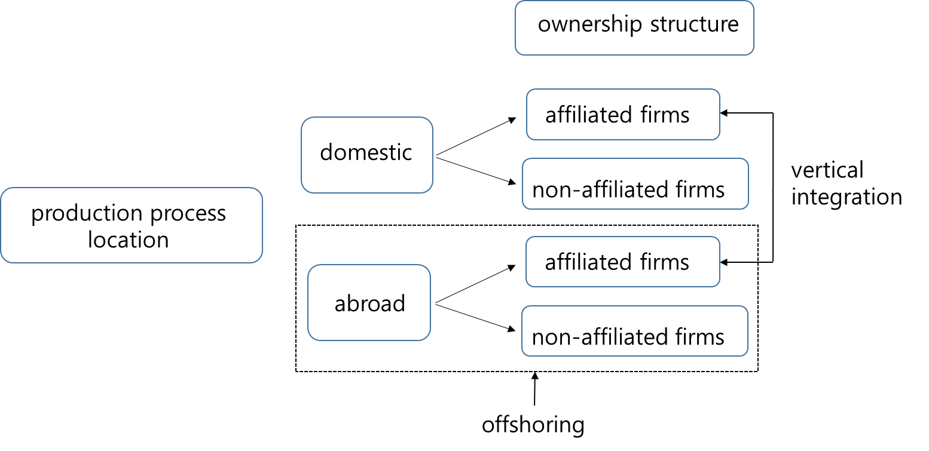
Structure of Production
Figure 1.
Note: This classification was suggested by Antras (2003).

Slide 11
Empirical Analysis

Slide 12
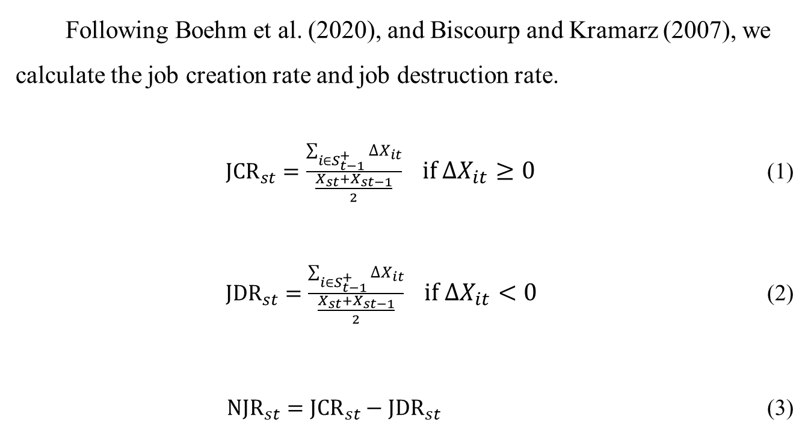
Job Creation and Job destruction Rate
Following Boehm et al. (2020), and Biscourp and Kramarz (2007), we calculate the job creation rate and job destruction rate.
${JCR}_{st}=\frac{\sum_{i∈S_{t−1}^{+}}{∆X_{it}}}{\frac{X_{st}+X_{st−1}}{2}} if ∆X_{it}≥0$ (1)
${JDR}_{st}=\frac{\sum_{i∈S_{t−1}^{+}}{∆X_{it}}}{\frac{X_{st}+X_{st−1}}{2}} if ∆X_{it}<0$ (2)
${NJR}_{st}={JCR}_{st}−{JDR}_{st}$ (3)
${∆X}_{ijt}=X_{ijt}−X_{ijt−1}$ is the change in employment in firm i and industry j. S represents the aggregated group.

Slide 13
JCR and JDR in South Korea

Slide 14
Net Job Creation Rate in South Korea

Slide 15

Baseline Specification
Based on the studies of Boehm et al. (2020), this study establishes the following equation for estimating employment growth.
$e_{ijt}=α_{0}+ ΒM_{ijt−1}+ ΓX_{ijt−1}+ YZ_{ijt−1}+v_{i}+η_{j}+Υ_{t}+ε_{ijt}$
$e_{ijt}=\frac{∆X_{ijt}}{\frac{X_{ijt}+X_{ijt−1}}{2}}$ as used in Davis and Haltiwanger (2001). ${∆X}_{ijt}=X_{ijt}−X_{ijt−1}$ is the change in employment in firm i and industry j between year t and t-1. If new firms enter the market, the employment growth rate is 2, whereas if firms exit the market it is -2.

Slide 16
Data
Annual unbalanced firm-level panel data on South Korean manufacturing industries from 2006–2019.
Statistics Korea conducted a survey of firms with at least 50 regular workers and capital of over KRW 0.3 billion.
These firms were classified into 24 manufacturing industries according to the Korean standard industrial classification.
We used the ISIC REV. 3 Technology Intensity Definition provided by OECD Directorate for Science, Technology, and Industry & Economic Analysis and Statistics Division (2011).

Slide 17
OECD Technology Level Definition

Slide 18
Empirical Results

Slide 19
Summary statistics for domestic firms, Korean MNEs, and foreign MNEs
 | All | Korean MNEs | Foreign MNEs | Domestic firms
Employment growth | 0.2899 (0.7231) | 0.2043 (0.6327) | 0.2279 (0.6527) | 0.3437 (0.7706)
Age | 21.89 (12.56) | 24.48 (13.80) | 22.08 (11.27 ) | 20.51 (11.82)
Employee | 300.20 (1880.34) | 574.58 (3194.47) | 418.85 (1739.83) | 140.94 (212.94)
Cash flow ratio | 0.0702 (1.5377) | 0.0555 (0.1317) | 0.1033 (0.1456) | 0.0734 (1.9800)
Tangible assets/employee | 155.19 (235.88) | 175.08 (248.66) | 171.16 (350.41) | 142.61 (206.50)
Exporter | 0.7218 (0.4481) | 0.8808 (0.3240 ) | 0.8831 (0.3213) | 0.6159 (0.4864)
Offshoring | 0.0625 (0.2420) | 0.1358 (0.3426 ) | 0.0743 (0.2624) | 0.0225 (0.1482)
Domestic sourcing | 0.7762 (0.4168) | 0.8185 (0.3855 ) | 0.6527 (0.4762) | 0.7712 (0.4201)
Intra-firm offshoring | 0.0321 (0.1763) | 0.0848 (0.2786 ) | 0.0419 (0.2005) | 0.0031 (0.0558 )
Arm’s length offshoring | 0.0305 (0.1719) | 0.0513 (0.2207 ) | 0.0326 (0.1775) | 0.0194 (0.1379 )
Intra-firm domestic sourcing | 0.0603 (0.2381) | 0.1125 (0.3160 ) | 0.0496 (0.2172) | 0.0344 (0.1824 )
Arm’s length domestic sourcing | 0.7160 (0.4510) | 0.7062 (0.4555 ) | 0.6032 (0.4893) | 0.7368 (0.4404)
Intra-firm offshoring value | 974.14 (41729.75) | 2859.73 (73387.90) | 774.13 (22361.75) | 12.65 (464.18)
Arm’s length offshoring value | 579.48 (9857.63) | 1526.04 (16503.90 ) | 393.15 (9850.20) | 108.88 (2130.60)
Intra-firm domestic sourcing value | 791.87 (22487.53) | 2029.03 (38727.91) | 841.93 (18597.23) | 135.92 (2267.28)
Arm’s length sourcing value | 8314.07 (78329.31 ) | 16987.63 (131859.40) | 8971.82 (76404.88) | 3682.04 (14602.27)
Observations | 77,196 | 24,330 | 6,510 | 46,419

Slide 20
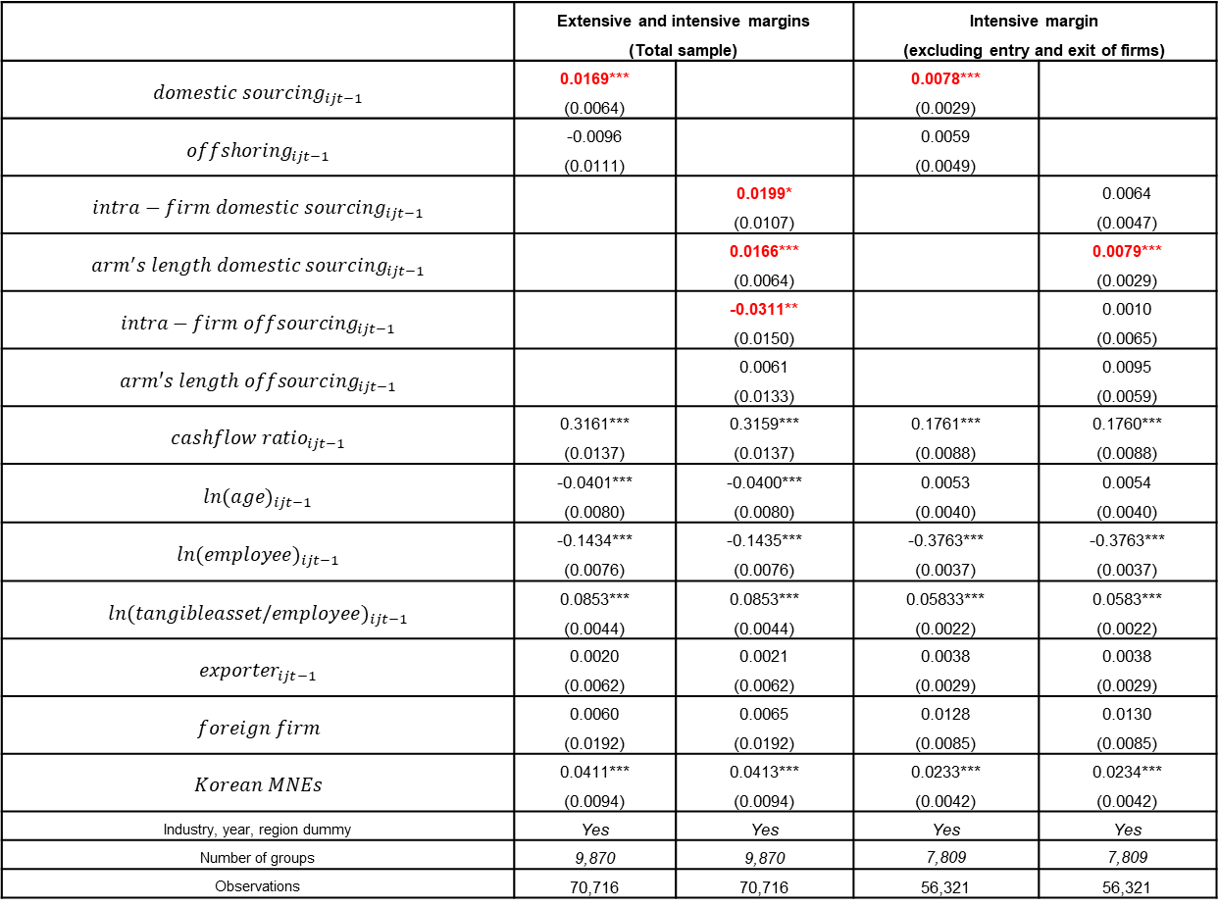
Result of Fixed Effect Model using dummy sourcing variable
 | Extensive and intensive margins (Total sample) |  | Intensive margin (excluding entry and exit of firms)
$${domestic sourcing}_{ijt−1}$$ | 0.0169*** (0.0064) |  | 0.0078*** (0.0029)
$${offshoring}_{ijt−1}$$ | -0.0096 (0.0111) |  | 0.0059 (0.0049)
$${intra−firm domestic sourcing}_{ijt−1}$$ |  | 0.0199* (0.0107) |  | 0.0064 (0.0047)
$${arm^{′}s length domestic sourcing}_{ijt−1}$$ |  | 0.0166*** (0.0064) |  | 0.0079*** (0.0029)
$${intra−firm offsourcing}_{ijt−1}$$ |  | -0.0311** (0.0150) |  | 0.0010 (0.0065)
$${arm′s length offsourcing}_{ijt−1}$$ |  | 0.0061 (0.0133) |  | 0.0095 (0.0059)
$${cashflow ratio}_{ijt−1}$$ | 0.3161*** (0.0137) | 0.3159*** (0.0137) | 0.1761*** (0.0088) | 0.1760*** (0.0088)
$${ln(age)}_{ijt−1}$$ | -0.0401*** (0.0080) | -0.0400*** (0.0080) | 0.0053 (0.0040) | 0.0054 (0.0040)
$${ln(employee)}_{ijt−1}$$ | -0.1434*** (0.0076) | -0.1435*** (0.0076) | -0.3763*** (0.0037) | -0.3763*** (0.0037)
$${ln(tangibleasset/employee)}_{ijt−1}$$ | 0.0853*** (0.0044) | 0.0853*** (0.0044) | 0.05833*** (0.0022) | 0.0583*** (0.0022)
$${exporter}_{ijt−1}$$ | 0.0020 (0.0062) | 0.0021 (0.0062) | 0.0038 (0.0029) | 0.0038 (0.0029)
$$foreign firm$$ | 0.0060 (0.0192) | 0.0065 (0.0192) | 0.0128 (0.0085) | 0.0130 (0.0085)
$$Korean MNEs$$ | 0.0411*** (0.0094) | 0.0413*** (0.0094) | 0.0233*** (0.0042) | 0.0234*** (0.0042)
Industry, year, region dummy | Yes | Yes | Yes | Yes
Number of groups | 9,870 | 9,870 | 7,809 | 7,809
Observations | 70,716 | 70,716 | 56,321 | 56,321

Slide 21
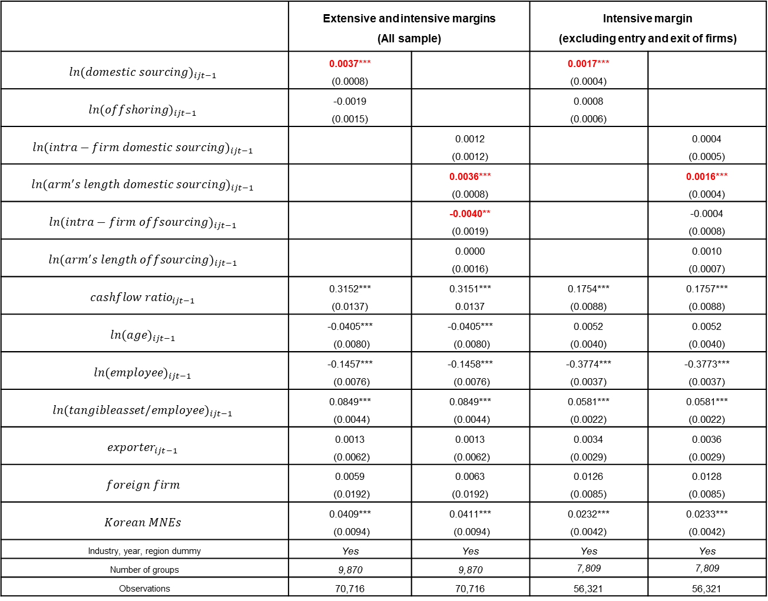
Result of Fixed Effect model using the continuous sourcing values
 | Extensive and intensive margins (All sample) |  | Intensive margin (excluding entry and exit of firms)
$${ln(domestic sourcing)}_{ijt−1}$$ | 0.0037*** (0.0008) |  | 0.0017*** (0.0004)
$${ln(offshoring)}_{ijt−1}$$ | -0.0019 (0.0015) |  | 0.0008 (0.0006)
$${ln(intra−firm domestic sourcing)}_{ijt−1}$$ |  | 0.0012 (0.0012) |  | 0.0004 (0.0005)
$${ln(arm^{′}s length domestic sourcing)}_{ijt−1}$$ |  | 0.0036*** (0.0008) |  | 0.0016*** (0.0004)
$${ln(intra−firm offsourcing)}_{ijt−1}$$ |  | -0.0040** (0.0019) |  | -0.0004 (0.0008)
$${ln(arm^{′}s length offsourcing)}_{ijt−1}$$ |  | 0.0000 (0.0016) |  | 0.0010 (0.0007)
$${cashflow ratio}_{ijt−1}$$ | 0.3152*** (0.0137) | 0.3151*** 0.0137 | 0.1754*** (0.0088) | 0.1757*** (0.0088)
$${ln(age)}_{ijt−1}$$ | -0.0405*** (0.0080) | -0.0405*** (0.0080) | 0.0052 (0.0040) | 0.0052 (0.0040)
$${ln(employee)}_{ijt−1}$$ | -0.1457*** (0.0076) | -0.1458*** (0.0076) | -0.3774*** (0.0037) | -0.3773*** (0.0037)
$${ln(tangibleasset/employee)}_{ijt−1}$$ | 0.0849*** (0.0044) | 0.0849*** (0.0044) | 0.0581*** (0.0022) | 0.0581*** (0.0022)
$${exporter}_{ijt−1}$$ | 0.0013 (0.0062) | 0.0013 (0.0062) | 0.0034 (0.0029) | 0.0036 (0.0029)
$$foreign firm$$ | 0.0059 (0.0192) | 0.0063 (0.0192) | 0.0126 (0.0085) | 0.0128 (0.0085)
$$Korean MNEs$$ | 0.0409*** (0.0094) | 0.0411*** (0.0094) | 0.0232*** (0.0042) | 0.0233*** (0.0042)
Industry, year, region dummy | Yes | Yes | Yes | Yes
Number of groups | 9,870 | 9,870 | 7,809 | 7,809
Observations | 70,716 | 70,716 | 56,321 | 56,321

Slide 22
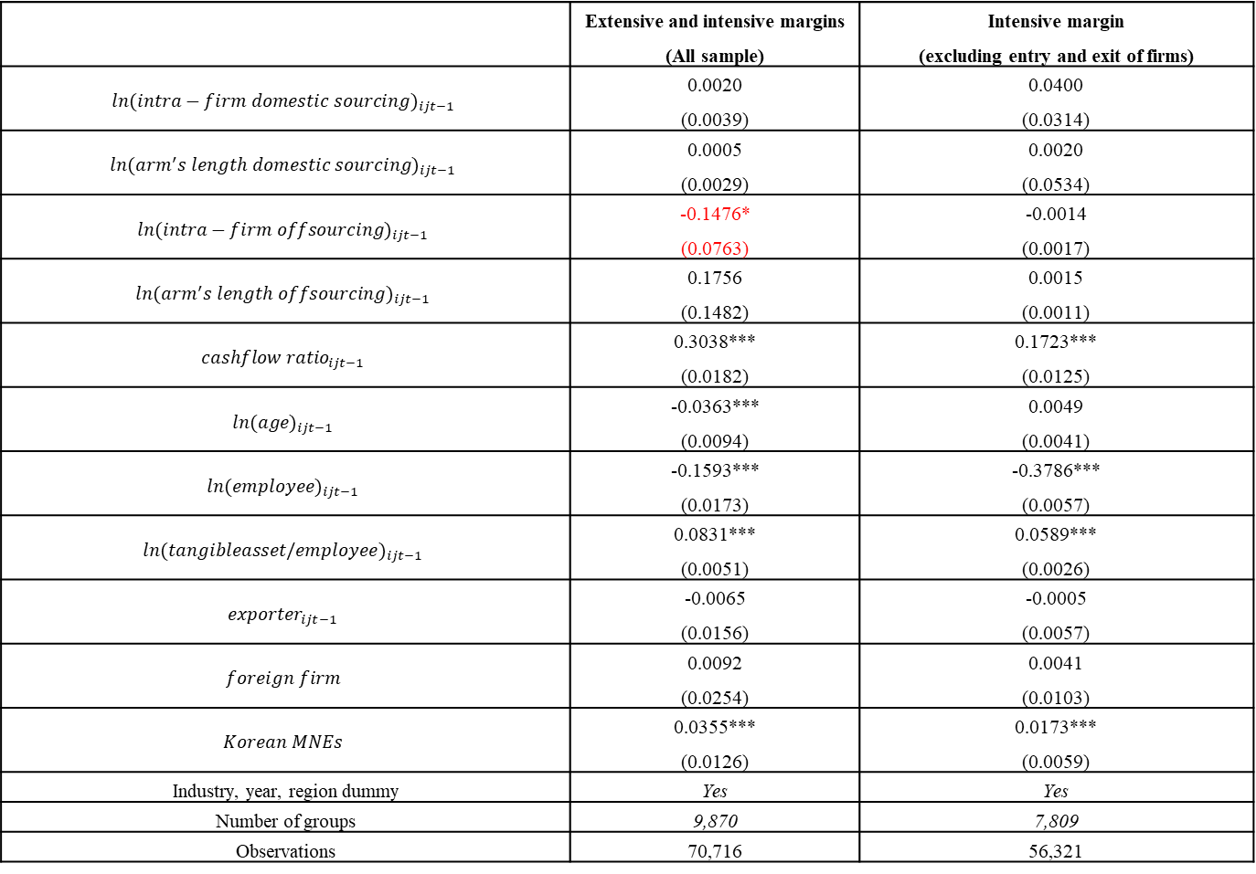
Fixed effects IV regression (2SLS)
 | Extensive and intensive margins (All sample) | Intensive margin (excluding entry and exit of firms)
$${ln(intra−firm domestic sourcing)}_{ijt−1}$$ | 0.0020 (0.0039) | 0.0400 (0.0314)
$${ln(arm^{′}s length domestic sourcing)}_{ijt−1}$$ | 0.0005 (0.0029) | 0.0020 (0.0534)
$${ln(intra−firm offsourcing)}_{ijt−1}$$ | -0.1476* (0.0763) | -0.0014 (0.0017)
$${ln(arm^{′}s length offsourcing)}_{ijt−1}$$ | 0.1756 (0.1482) | 0.0015 (0.0011)
$${cashflow ratio}_{ijt−1}$$ | 0.3038*** (0.0182) | 0.1723*** (0.0125)
$${ln(age)}_{ijt−1}$$ | -0.0363*** (0.0094) | 0.0049 (0.0041)
$${ln(employee)}_{ijt−1}$$ | -0.1593*** (0.0173) | -0.3786*** (0.0057)
$${ln(tangibleasset/employee)}_{ijt−1}$$ | 0.0831*** (0.0051) | 0.0589*** (0.0026)
$${exporter}_{ijt−1}$$ | -0.0065 (0.0156) | -0.0005 (0.0057)
$$foreign firm$$ | 0.0092 (0.0254) | 0.0041 (0.0103)
$$Korean MNEs$$ | 0.0355*** (0.0126) | 0.0173*** (0.0059)
Industry, year, region dummy | Yes | Yes
Number of groups | 9,870 | 7,809
Observations | 70,716 | 56,321

Slide 23
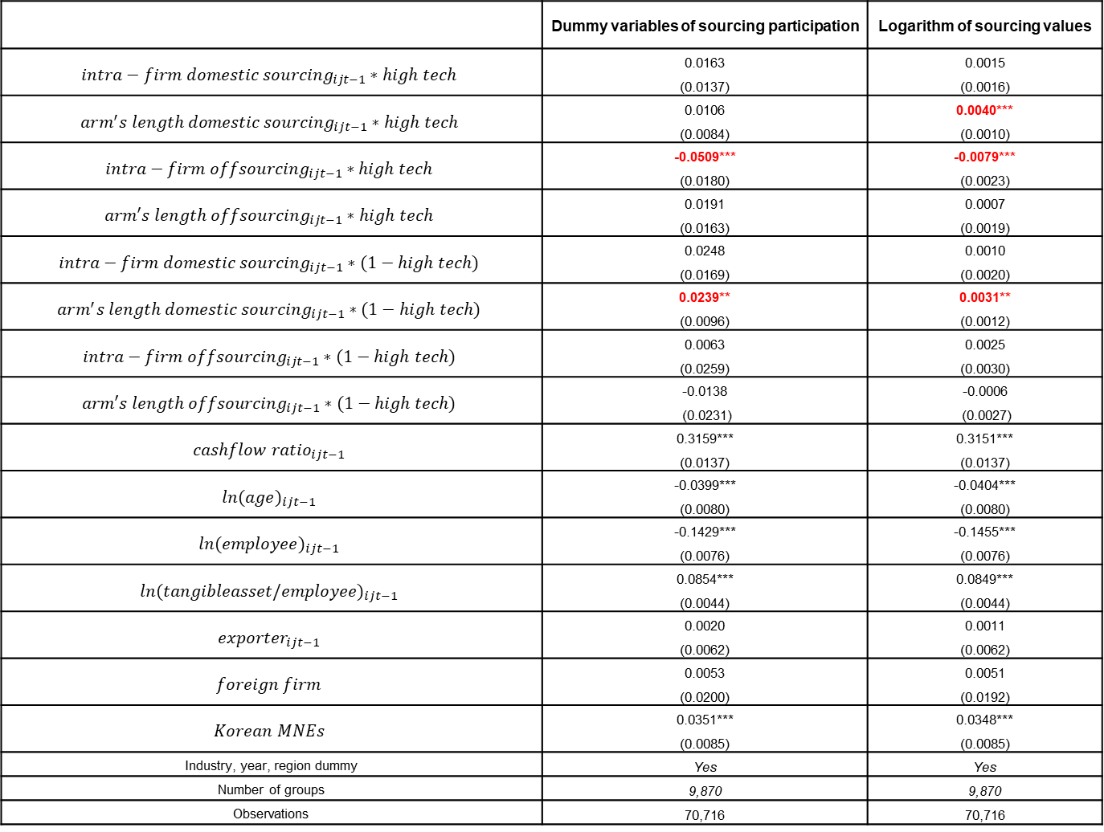
High-technology versus low-technology industries
 | Dummy variables of sourcing participation | Logarithm of sourcing values
$${intra−firm domestic sourcing}_{ijt−1}∗high tech$$ | 0.0163 (0.0137) | 0.0015 (0.0016)
$${arm^{′}s length domestic sourcing}_{ijt−1}∗high tech$$ | 0.0106 (0.0084) | 0.0040*** (0.0010)
$${intra−firm offsourcing}_{ijt−1}∗high tech$$ | -0.0509*** (0.0180) | -0.0079*** (0.0023)
$${arm′s length offsourcing}_{ijt−1}∗high tech$$ | 0.0191 (0.0163) | 0.0007 (0.0019)
$${intra−firm domestic sourcing}_{ijt−1}∗(1−high tech)$$ | 0.0248 (0.0169) | 0.0010 (0.0020)
$${arm^{′}s length domestic sourcing}_{ijt−1}∗(1−high tech)$$ | 0.0239** (0.0096) | 0.0031** (0.0012)
$${intra−firm offsourcing}_{ijt−1}∗(1−high tech)$$ | 0.0063 (0.0259) | 0.0025 (0.0030)
$${arm′s length offsourcing}_{ijt−1}∗(1−high tech)$$ | -0.0138 (0.0231) | -0.0006 (0.0027)
$${cashflow ratio}_{ijt−1}$$ | 0.3159*** (0.0137) | 0.3151*** (0.0137)
$${ln(age)}_{ijt−1}$$ | -0.0399*** (0.0080) | -0.0404*** (0.0080)
$${ln(employee)}_{ijt−1}$$ | -0.1429*** (0.0076) | -0.1455*** (0.0076)
$${ln(tangibleasset/employee)}_{ijt−1}$$ | 0.0854*** (0.0044) | 0.0849*** (0.0044)
$${exporter}_{ijt−1}$$ | 0.0020 (0.0062) | 0.0011 (0.0062)
$$foreign firm$$ | 0.0053 (0.0200) | 0.0051 (0.0192)
$$Korean MNEs$$ | 0.0351*** (0.0085) | 0.0348*** (0.0085)
Industry, year, region dummy | Yes | Yes
Number of groups | 9,870 | 9,870
Observations | 70,716 | 70,716

Slide 24
Conclusion

Slide 25
Conclusion
Investigating the effect of offshoring and domestic sourcing on firm’s employment growth, and examines activities occurring within affiliated versus non-affiliated firms that have different effects on employment growth.
Significant heterogeneity in the effect of sourcing strategies on employment growth, which depends on firms’ technology level.
Indicating that vertical international integration production processes among MNEs has a negative effect on employment growth.
Decline in the employment growth is associated with the closure or downsizing size of firms, indicating extensive margin can explain the decline in firms’ employment growth.

